Slide 1
The Risk to Space: Cybersecurity in the New High Ground
Scott Lynch
Senior Engineer, Security Onion Solutions

Slide 2
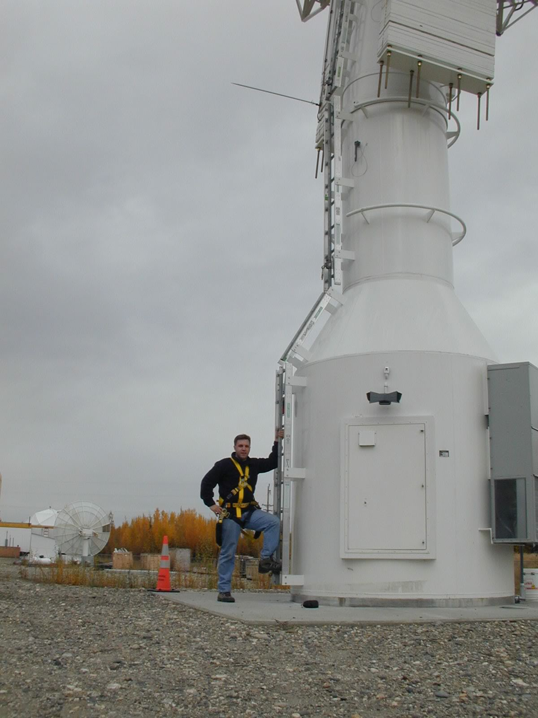
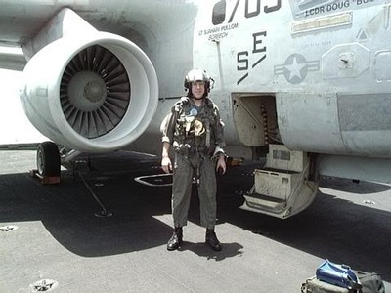
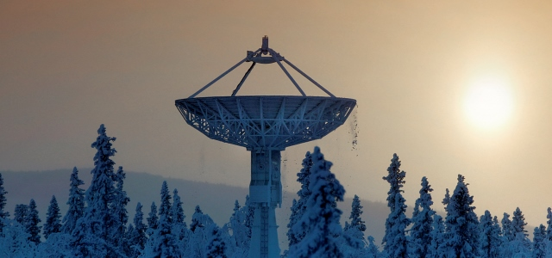
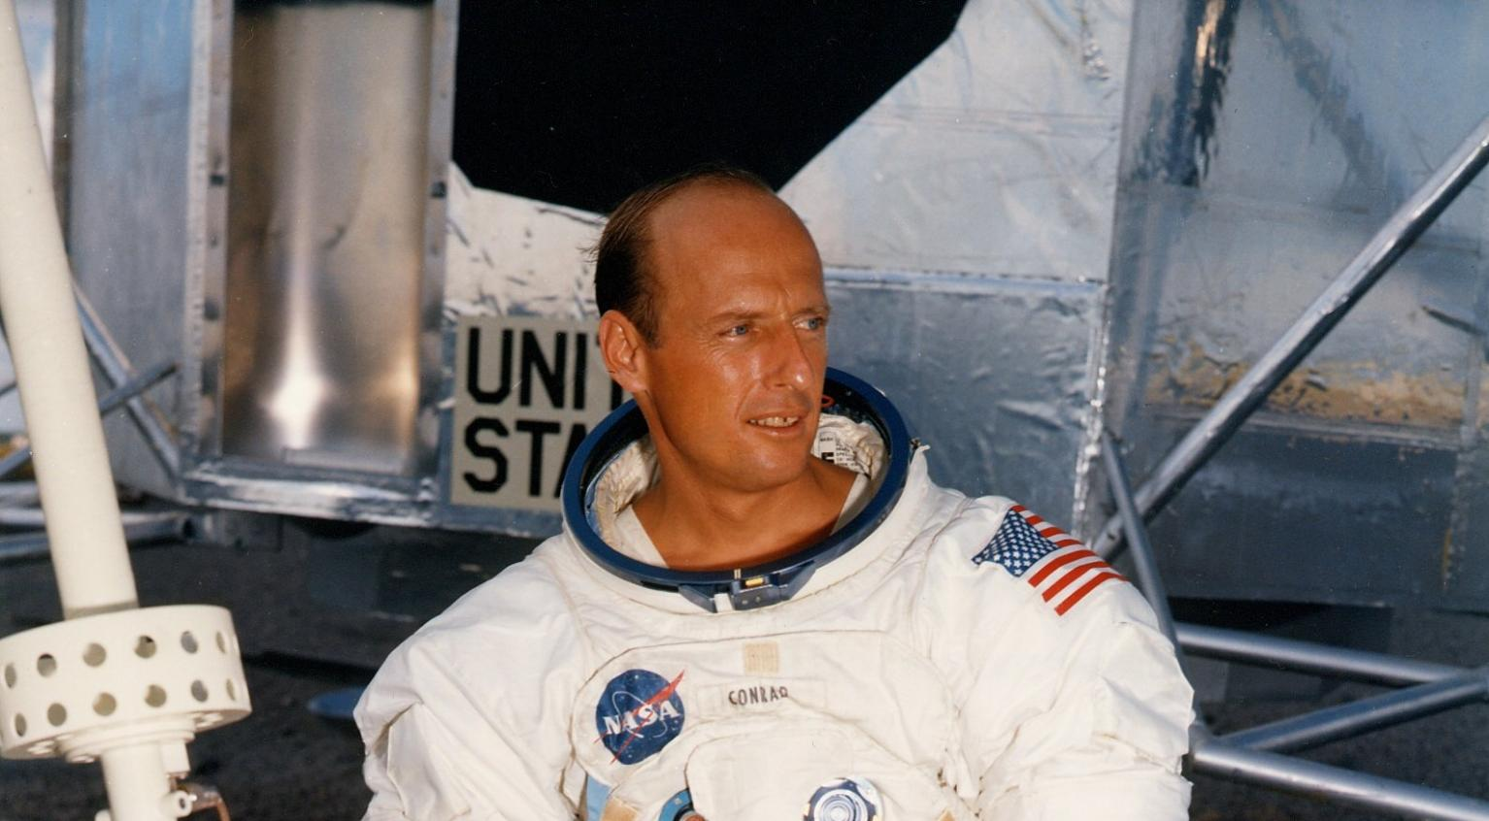
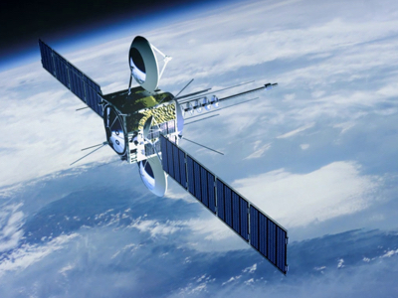
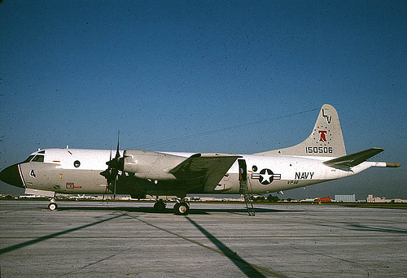
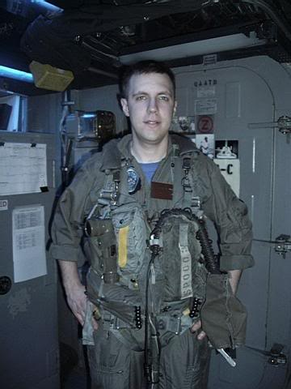


Who am I?
Scott Lynch
Scott.Lynch@SLTekSystems.com
Twitter/LinkedIn @PacketEngineer
SANS Certified Instructor/Prior Author
SEC555: SIEM with Tactical Analytics
Senior Engineer, Security Onion Solutions
Founder/CEO, SLTek Systems
25+ Years in the Space Industry
Cisco Instructor/Adjunct Professor BCCC
US Navy Veteran, Electronic Warfare/IFO
GCDA, GDSA, GCIH, GNFA, CCNP-S, CCAI

Slide 3
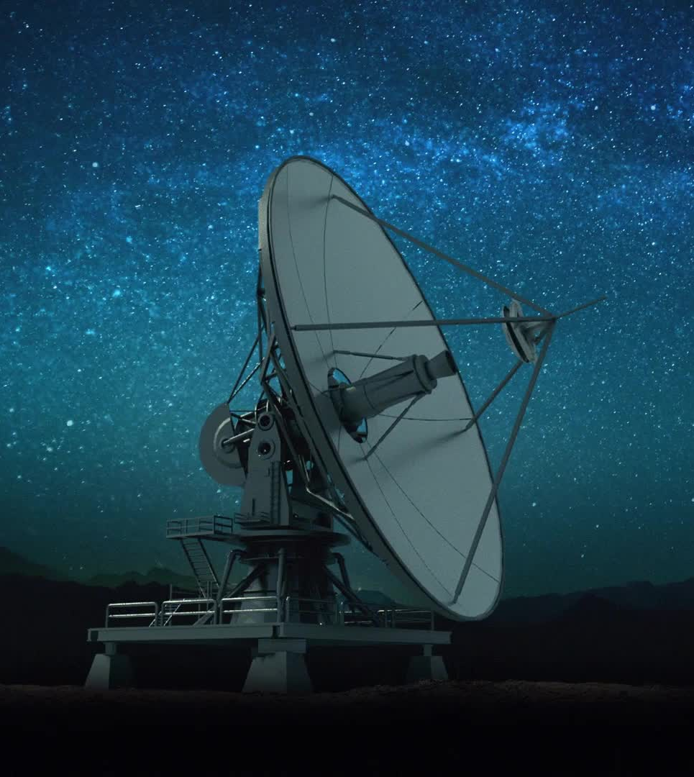
Our Reliance on Space
"From the moment we wake up to the instant we drift off to sleep, our daily lives are intricately woven with the threads of space systems, highlighting the indispensable role these celestial technologies play in shaping the tapestry of human existence on our Pale Blue Dot.“
-ChatGPT 2023
Notes:
Cyberattacks on Satellites An Underestimated Political Threat
https://www.lse.ac.uk/ideas/projects/space-policy/publications/Cyberattacks-on-Satellites

Slide 4
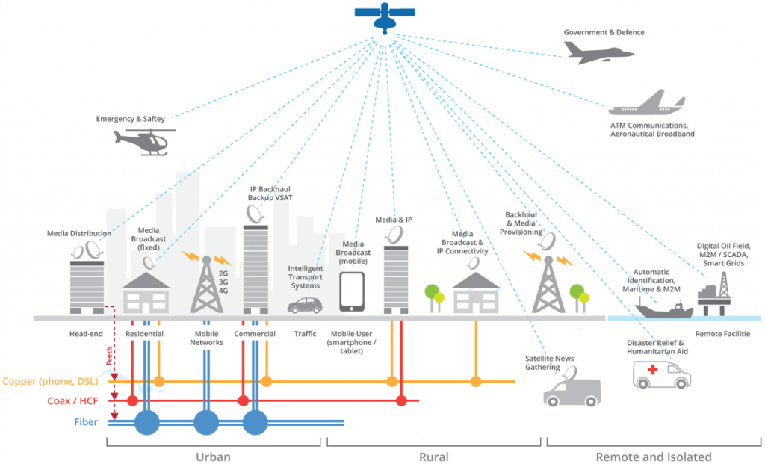
Satellite and Wireless Together

Slide 5


Snapshot of the SATCOM Industry
Market value estimated at 200.3 billion USD in 2025 expected to grow
Commercial Space Growth
Massive Small Sat Constellations
The Moon and beyond
5G Use in Space
NB 5G-IoT satellite communications
Notes:
TOTUM https://totum.global/solution/
ROCKETLAB https://www.rocketlabusa.com/
ASTROSCALE https://astroscale.com/
RelativitySpace https://www.relativityspace.com/
SPACEX Starship https://www.spacex.com/vehicles/starship/
Planet https://www.planet.com/
NASA Artemis https://www.nasa.gov/specials/artemis/
SATELIOT https://sateliot.space/en/
https://spacenews.com/op-ed-nb-5g-iot-is-the-next-big-thing-in-the-space-industry/
https://www.mordorintelligence.com/industry-reports/global-satellite-communication-market

Slide 6

Innovation in Space
Rapid Growth
Failing forward Fast
Lowering the barrier to entry
Building, Launching and Operating spacecraft
Move to cloud
The push to Software as a Service (SaaS) solutions
IoT In Space
NASA's IoT Lab
Sateliot
Pushing the boundaries of Commercial off the shelf Technology (COTS)
Adoption of Minimum Viable Product (MVP)

Slide 7
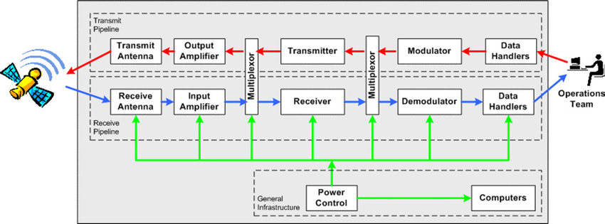
Typical Satellite communications Ground Station

Slide 8
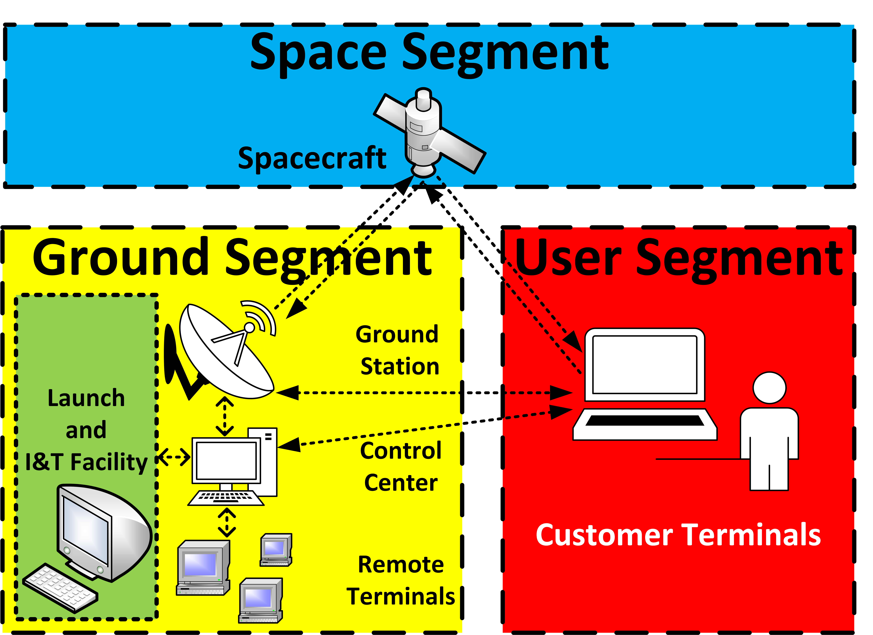
Typical Ground Station to Customer Architecture
Customer connects to ground station via terrestrial network of ISPs to ground station controller's network of ground stations
Ground station is configured with correct uplink/downlink parameters and pointing information to receive signals by ground station controllers
Telemetry and Commands routed back to customer via ground station terrestrial network

Slide 9
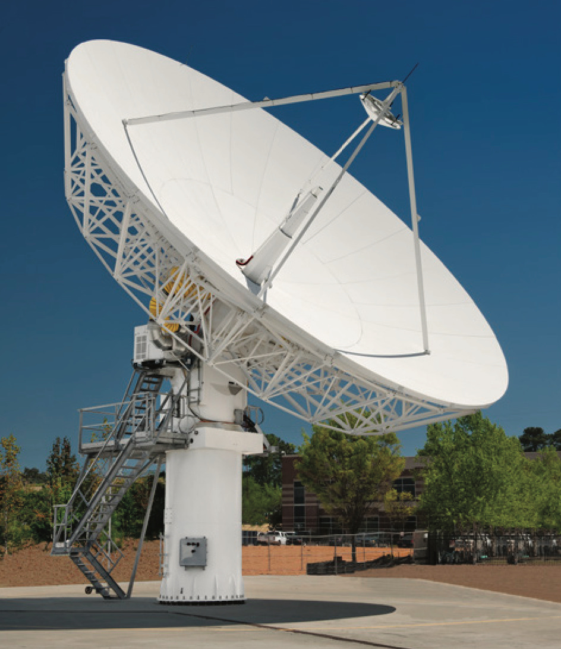
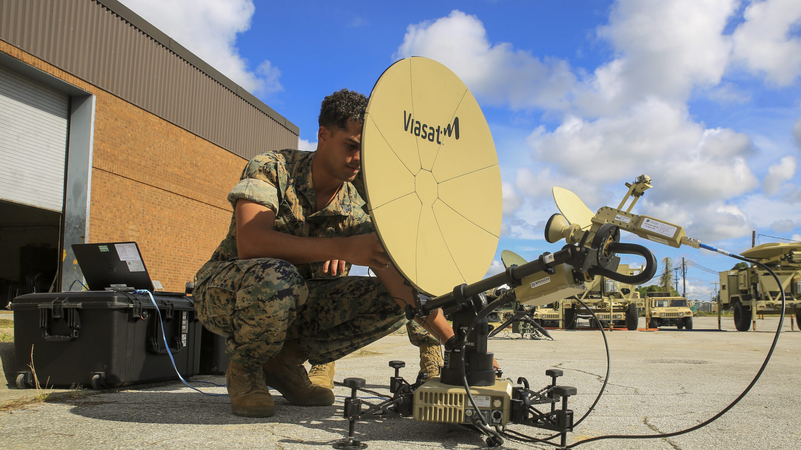
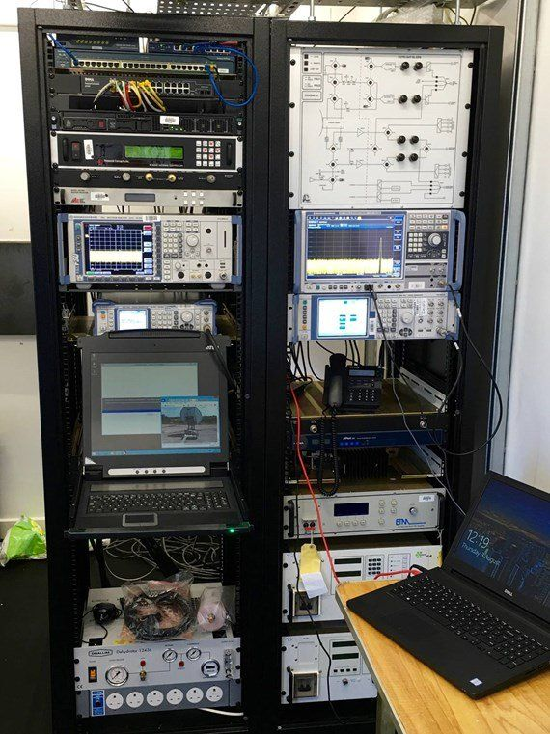
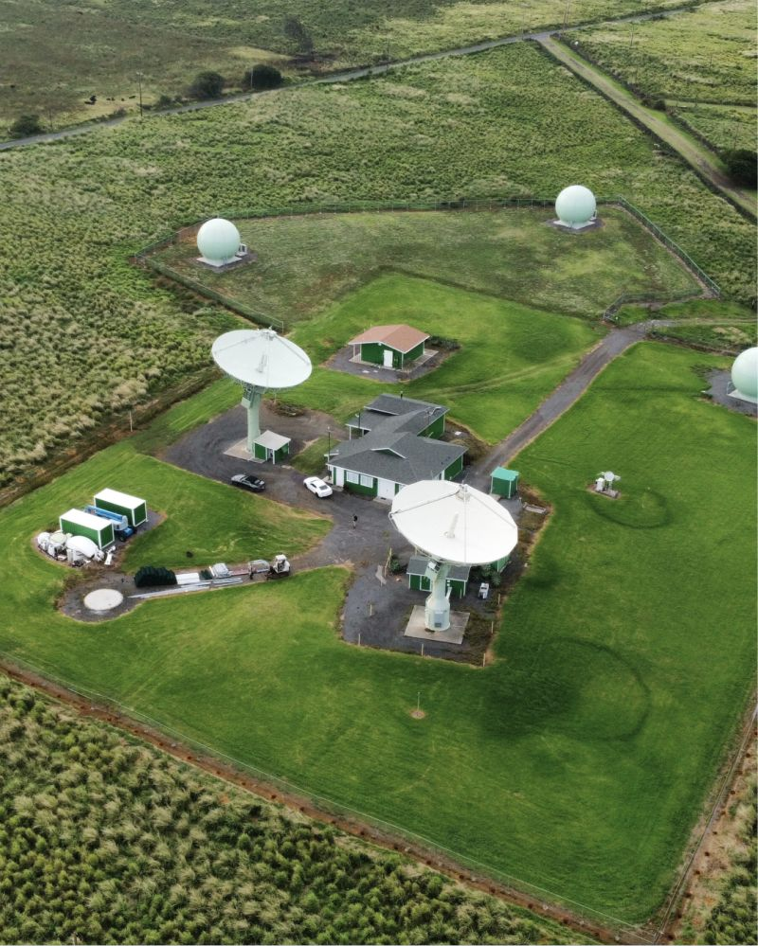
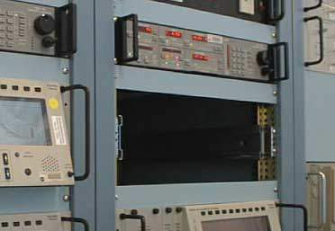
Ground Station Terminals, Antennas and Equipment
Viasat Ground terminals
Typical radio rack
Satcom receiver
Viasat 13.5m Ka-band Broadband Gateway Earth Station Antenna
South Point Station, Hawaii

Slide 10
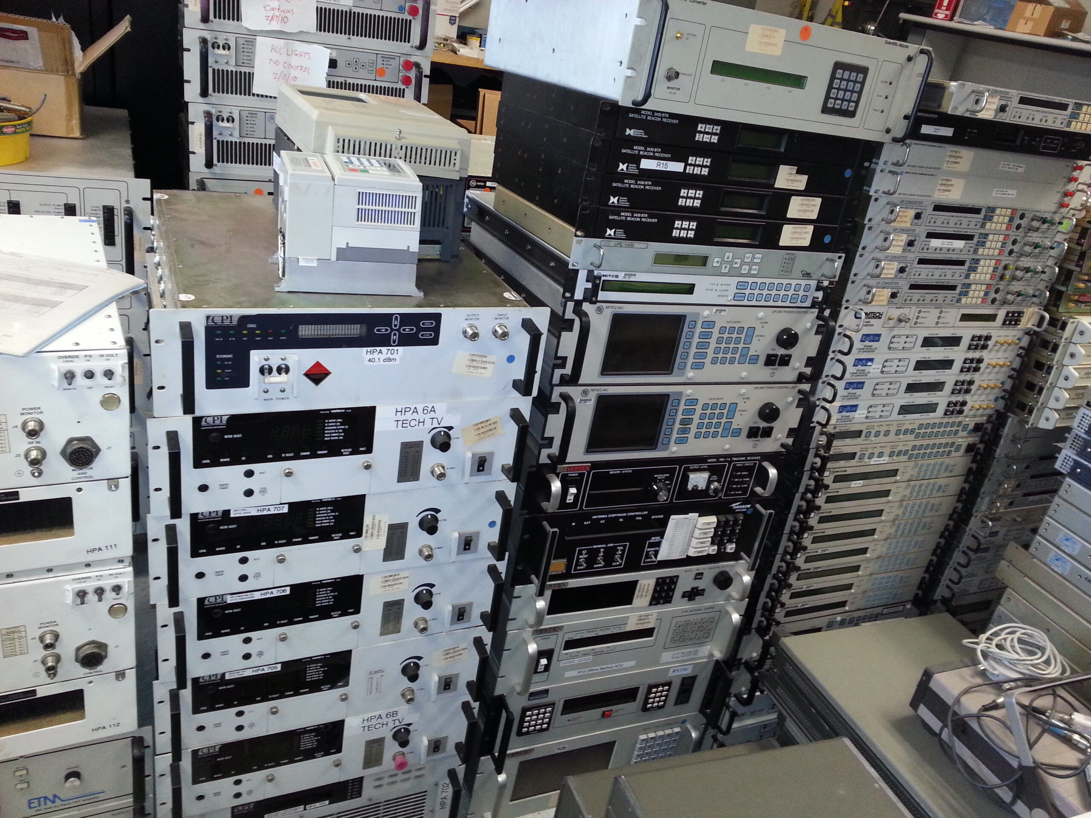
Legacy Satcom Ground Station Equipment
Purpose built
Solid state
Mechanical
Upgradeable but at hardware level
Usually controlled over serial

Slide 11
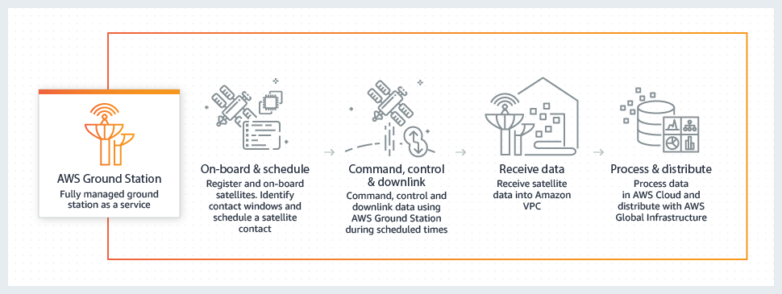
Cloud Based Ground Stations
https://aws.amazon.com/ground-station/

Slide 12
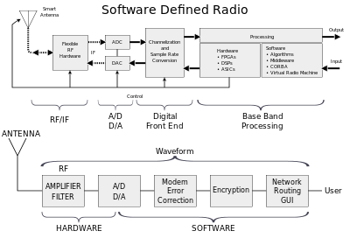
Software Defined Radio (SDR)
“A radio communication system where components that have been traditionally implemented in analog hardware (e.g., mixers, filters, amplifiers, modulators/demodulators, detectors, etc.) are instead implemented by means of software on a personal computer or embedded system”
https://en.wikipedia.org/wiki/Software-defined_radio

Slide 13
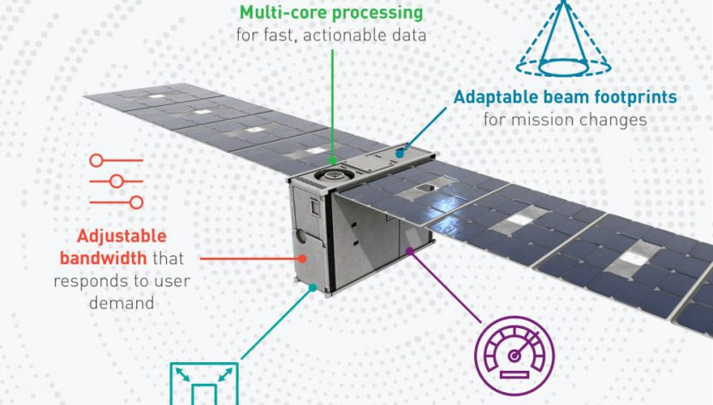
Software-Defined Satellites
SDR in Space
GEO to start LEO to follow
5G increased usage and deployment
Connect massive numbers of Internet of Things (IoT) sensors and devices
Voice & Data services for commercial, protected, and secure communications anywhere.
LEO to benefit
IP in Space
Lockheed Martin’s nanosatellite bus, the LM 50
Notes:
https://satelliteprome.com/news/operators/satellite/software-defined-satellites-shaping-the-future-of-communications/
https://www.satellitetoday.com/innovation/2019/03/21/lockheed-martin-accelerates-transition-to-software-defined-space/

Slide 14
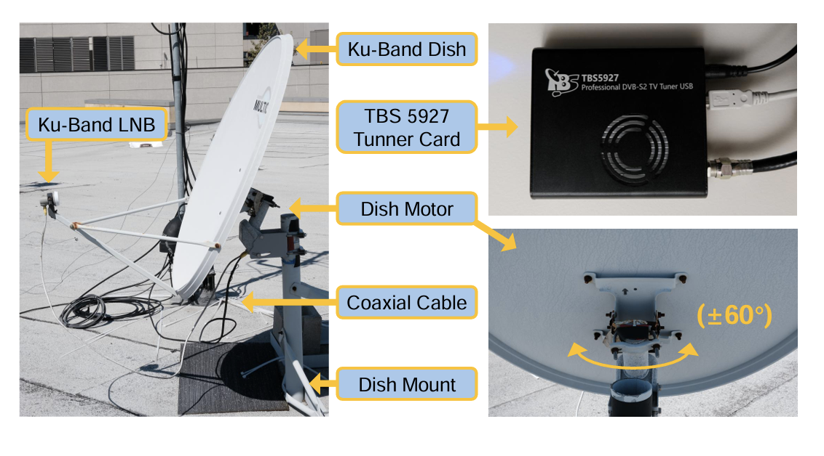

Study: Eavesdropping on Internal Networks via Unencrypted Satellites
Consumer-grade satellite dish on the roof of a university building in San Diego, California
Positioning motor for the antenna
Consumer-grade TV tuner card to capture raw bytes.
Scanned for all transponders (position and frequency)
Used custom protocol-parsing code to reconstruct network packets.
Observed 411 transponders across 39 GEO satellites, and our single fixed-location dish could receive IP traffic from 14% of all global Ku-band satellites.
https://satcom.sysnet.ucsd.edu/

Slide 15
Eavesdropping on Internal Networks via Unencrypted Satellites – Cont.
Cellular Backhaul
Unencrypted calls, SMS
End user Internet traffic
Hardware IDs (e.g. IMSI)
Cellular communication encryption keys.
Military and Government
Unencrypted VoIP
Internet traffic
Encrypted internal communications from ships, traffic for military
Detailed tracking data for coastal vessel surveillance
Police force operations
In‑flight Wi‑Fi
Unprotected passenger Internet traffic destined for in-flight Wi-Fi
Passenger web browsing (DNS lookups and HTTPS traffic)
Encrypted pilot flight‑information systems
In‑flight entertainment.
VoIP
Multiple VoIP providers were using unencrypted satellite backhaul, exposing
Unencrypted call audio
End user metadata
Internal Commercial Networks
Retail, financial, and banking companies all used unencrypted satellite communications for their internal networks.
Observed unencrypted
Login credentials
Corporate emails
Inventory records
ATM networking information.
Critical Infrastructure
Power utility companies and oil and gas pipelines used GEO satellite links to support remotely operated SCADA infrastructure and power grid repair tickets.
https://satcom.sysnet.ucsd.edu/

Slide 16

What if we lost access?
Communication
voice, data, and video services across the US and the world.
Navigation (GPS)
Aviation
Maritime
Ground-based navigation,
Emergency services
Agriculture
Surveying and mapping
Cellular Communications
Financial services
Financial transactions
Stock trading
Point of Sales Systems (POS)
Weather Forecasting
Television and Radio Broadcasting
Space Exploration

Slide 17
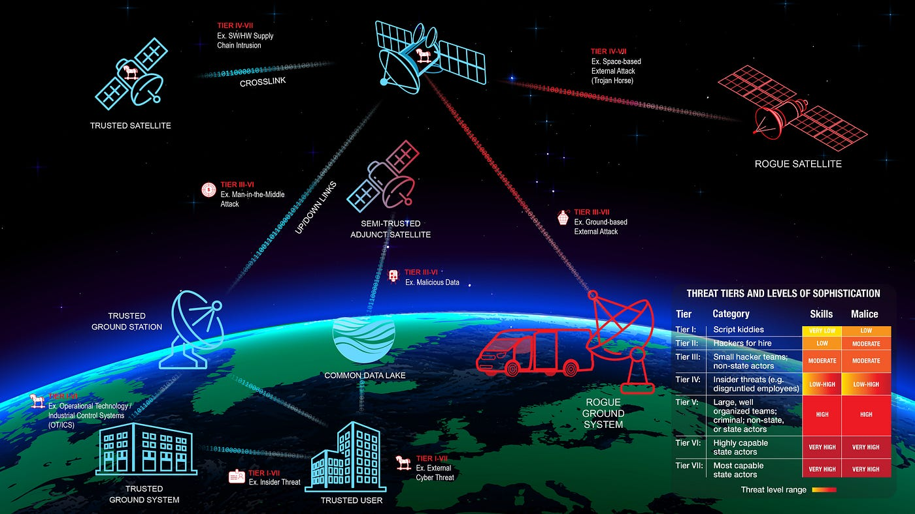
Threats and Risks
Nation State Actors
Supply Chain
Software/Hardware Vulnerabilities
Cyber Attack
Denial of Service
Hacktivism
Ransomware
Physical Attack
Threats to Remote Sensing Satellites ACCRES Briefing
Notes:
https://www.nesdis.noaa.gov/s3/2022-08/1.%20ACCRES%20-%20Space%20ISAC%20Brief.pdf

Slide 18
Cyber Intrusion or Breach – Examples from NASA
2009 - A cyberattacker successfully penetrated a computer system at JPL and extracted approximately 22 gigabytes of program data by illegally transferring the information to an Internet Protocol (IP) address in China.
The stolen data included information protected under International Traffic in Arms Regulations and Export Administration Regulations (ITAR)
2016 – A website misconfiguration resulted in an anonymous user gaining elevated privileges that enabled an individual to execute codes on a server used for software architecture development.
The use of Secure Sockets Layer, which ensures that all data transmitted between the web server and browser remains encrypted, prevented JPL’s network security monitoring tools from identifying the actions taken by the bad actor prior to detection.
2011 - JPL discovered Chinese-based IP addresses in which cyber intruders gained full access to 18 servers supporting key JPL missions, including the DSN and Advanced Spaceborne Thermal Emission and Reflection Radiometer mission, and sensitive user accounts
With full system access, the intruders were able to: (1) copy, modify, or delete sensitive files; (2) add, modify, or delete user accounts for mission-critical JPL systems; (3) upload hacking tools to steal user credentials and compromise other NASA systems; and (4) modify system logs to conceal their actions. Intruders resided within the system for 2 weeks before being detected and analysis of intrusion detection system log files revealed 87 gigabytes of data had been uploaded to the attackers’ IP addresses
2017 - A JPL server that runs source code used in ground operations for scientific spacecraft was compromised by foreign hackers who exploited a flaw in the software, hardware, or firmware that was previously unknown to JPL.
As a result, the intruders remotely executed a code on the server without authentication. After gaining access to the server, the hackers were able to upload, manipulate, and execute various files and commands unrelated to controlling spacecraft.
2014 - JPL discovered a cyber intruder was able to upload malware to a server supporting JPL astronomical missions and research after a web-based program installed by the system’s administrator allowed the public to upload and execute files on the server.
Investigation of the compromise revealed the administrator failed to update the software in a timely manner, providing the attacker an opportunity for unauthorized access via a JPL computer
Notes:
https://oig.nasa.gov/docs/IG-19-022.pdf

Slide 19
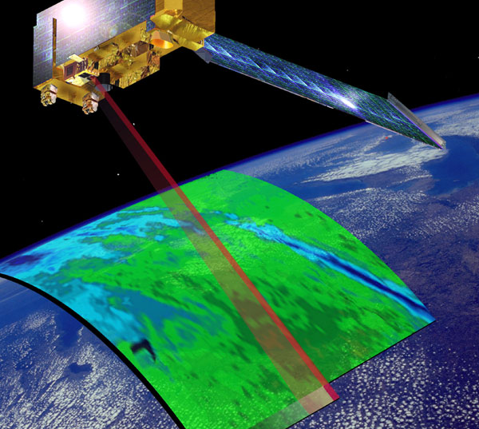
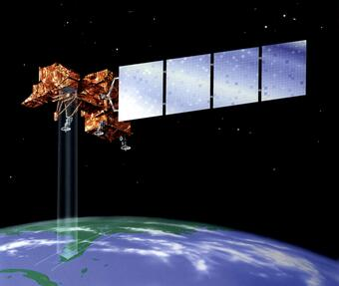
Chinese Accused of Interference of Two Satellites
Events occurred in 2007/2008
Moments of “interference”
Chinese threat actors blamed
During the final hack ‘the responsible party achieved all steps required to command the satellite’, but did not do so.
Terra
Landsat-7
Notes:
Terra https://www.nasa.gov/mission_pages/terra/spacecraft/index.html
Landsat-7 https://landsat.gsfc.nasa.gov/satellites/landsat-7/
https://www.dailymail.co.uk/news/article-2062755/Real-life-Star-Wars-Were-Chinese-hackers-attacks-U-S-military-satellites.html
https://www.theguardian.com/technology/2011/oct/27/chinese-hacking-us-satellites-suspected

Slide 20
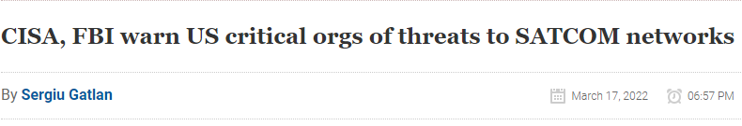
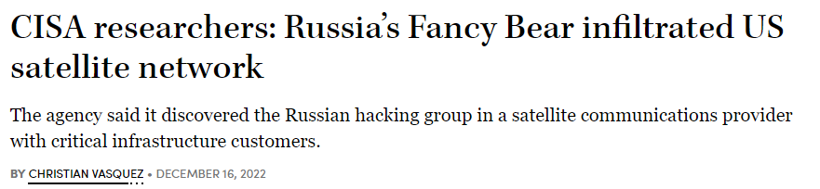
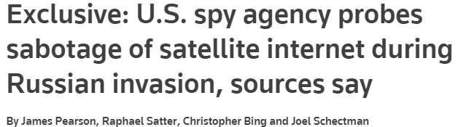
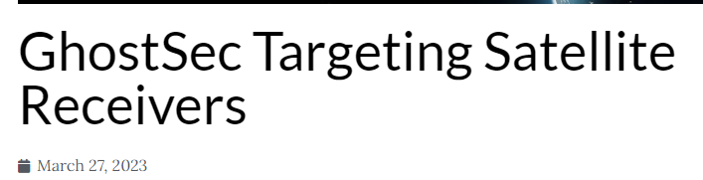
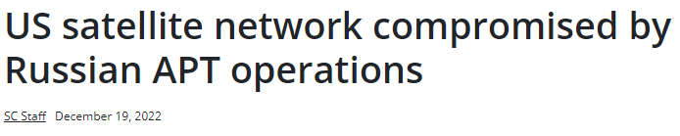
Supply Chain Attacks and Risk
Notes:
A History of Software Supply Chain Attacks https://www.sonatype.com/resources/vulnerability-timeline
GhostSec Targeting Satellite Receivers https://blog.cyble.com/2023/03/27/ghostsec-targeting-satellite-receivers/
OTORIO reveals GhostSec hacktivist group now targets Iranian ICS in support of Hijab protests https://industrialcyber.co/news/otorio-reveals-ghostsec-hacktivist-group-now-targets-iranian-ics-in-support-of-hijab-protests/
Dragos’ third quarter data says ransomware continues as one of most threatening financial and operational risks to industrial organizations
https://industrialcyber.co/ransomware/dragos-third-quarter-data-says-ransomware-continues-as-one-of-most-threatening-financial-and-operational-risks-to-industrial-organizations/
GhostSec hackers target satellite receivers, as threats toward satellite communication networks gradually rise
https://industrialcyber.co/threat-landscape/ghostsec-hackers-target-satellite-receivers-as-threats-toward-satellite-communication-networks-gradually-rise/
The Growing Risk of a Major Satellite Cyber Attack https://interactive.satellitetoday.com/the-growing-risk-of-a-major-satellite-cyber-attack/

Slide 21
ViaSat Cyber Attack prior to Russia/Ukraine War
Russian hacking group Fancy Bear/APT 28
Infiltrated Satcom Provider ViaSat
Attacker exploited Skylogic's VPN appliance
Remote access to KA-SAT's network management segment
Overwrote key data in the flash memory on the SurfBeam modems
10k Viasat modems
On the 24th of February, the KA-Sat satellite network was disrupted across several countries in Europe due to a cyber attack, leading to an interruption of broadband services for some customers (including some bigblu customers) on the network.
https://cyberscoop.com/apt28-fancy-bear-satellite/
Notes:
https://www.satellitetoday.com/cybersecurity/2022/04/11/experts-say-viasat-cyber-attacks-exposed-ground-terminal-satellite-supply-chain-vulnerabilities/

Slide 22

Could This Happen Again?
Mebromi
Hacking Team UEFI Rootkit
Equation Group and Vault 7 Leaks
LoJax
MosaicRegressor
Trickbot
FinSpy
Especter
MoonBounce
CosmicStrand
BlackLotus
Notes:
https://eclypsium.com/blog/endpoint-firmware-attack-timeline-introduction/
https://securelist.com/moonbounce-the-dark-side-of-uefi-firmware/105468/
https://www.reuters.com/article/us-china-cyber-moonlighters-idUSKCN1UX1JE
https://securelist.com/moonbounce-the-dark-side-of-uefi-firmware/105468/

Slide 23
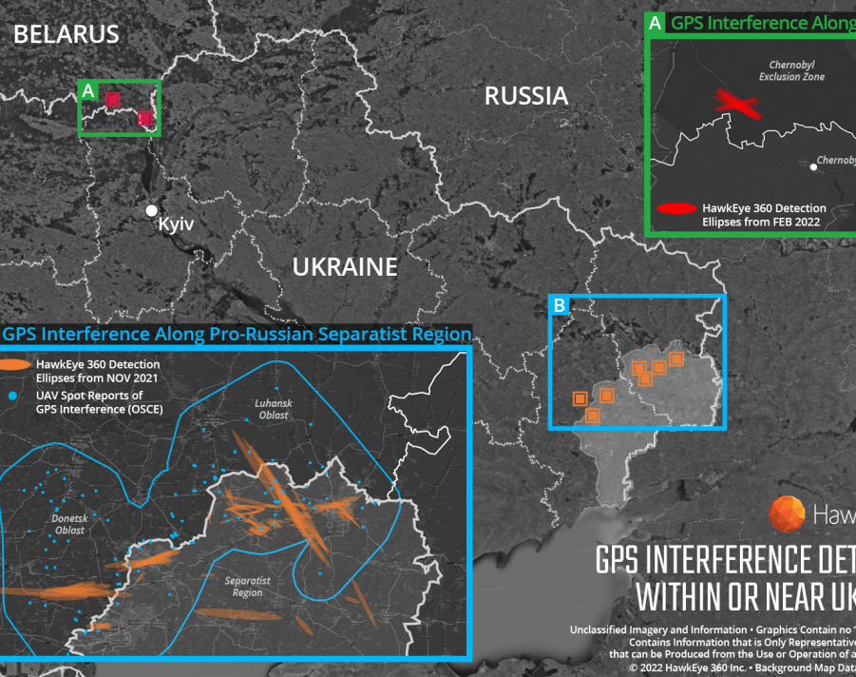
GPS Jamming
Reports of massive GPS interference along the Ukraine-Belarus border.
The activity was detected just north of Chernobyl, within the Chernobyl Exclusion Zone
Hawkeye 360, said on March 4, calling it a demonstration of the
“integration of electronic warfare tactics into Russian military operation to further degrade Ukraine’s ability for self-defense”.

Slide 24
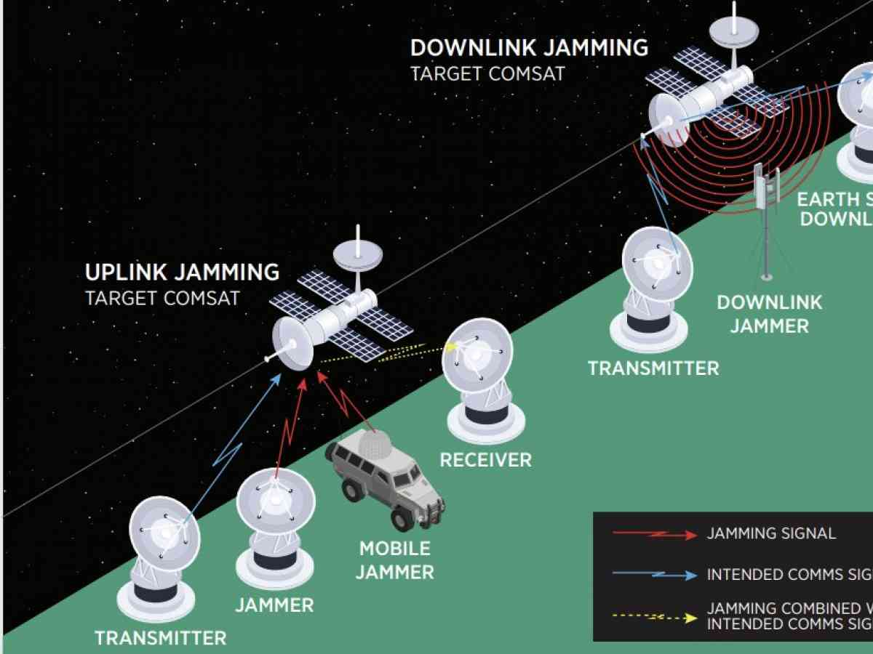
Electronic Warfare
Uplink
Downlink
Signal Spillage and Intercept
Spacecraft Fingerprinting
Three Modes of EW
Electronic Attack (EA)
Electronic Protect (EP)
Electronic Support (ES)
Electronic Warfare (The US Defense Intelligence Agency)
Notes:
https://m.koreaherald.com/view.php?ud=20220413000743\
https://www.ausa.org/sites/default/files/publications/LWP-115-Satellite-and-Ground-Communication-Systems-Space-and-Electronic-Warfare-Threats-to-the-United-States-Army.pdf

Slide 25
Other Scenarios
Ransomware
Denial of Service
Jamming Ground and Satellite
Hacktivism
Physical Attacks
Power, Terrestrial ISP’s and ground infrastructure
Insider Threat

Slide 26
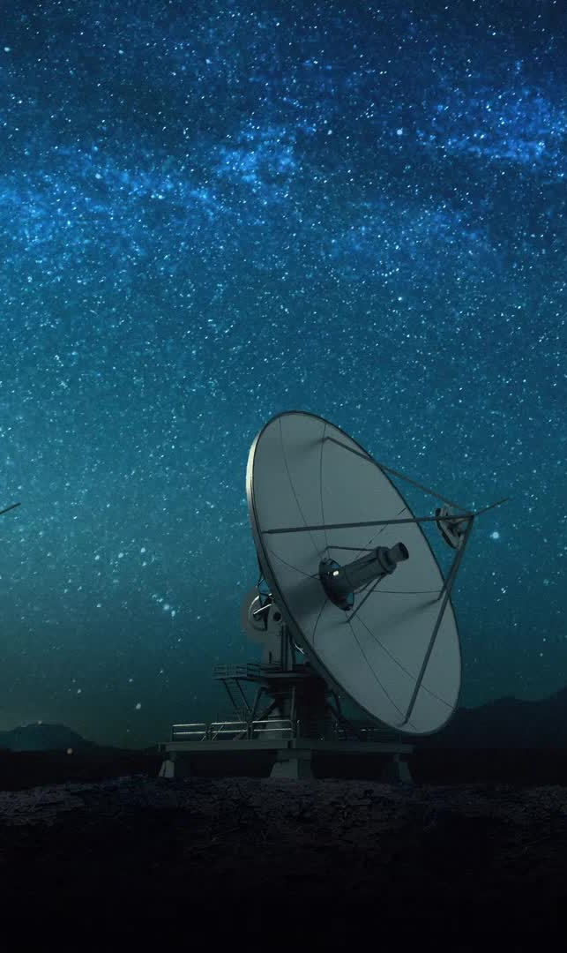
Protection Starting Points
Implement Zero Trust and Segmentation
End to End Encryption
Monitoring, Monitoring, Monitoring …
Physical Security
Forensics and Incident Response (IR) Capabilities
Awareness Training
Tabletop Exercises and Planning for Breaches
Audits and Risk Assessments

Slide 27

Detection and Defense
Inventory of Hardware and Software Assets
Document findings
Technical Debt
Retire of End of Life (EOL) Operating Systems and Hardware
User Awareness Training
Use your “Human IDS” to your benefit
Tripwires and Honeypots
Low-cost, High Value Indicator with Detections
Centrally Collect and Analyze Logs
Don’t just collect them, use them!!
Network Security Monitoring (NSM)
Security Onion/Zeek

Slide 28
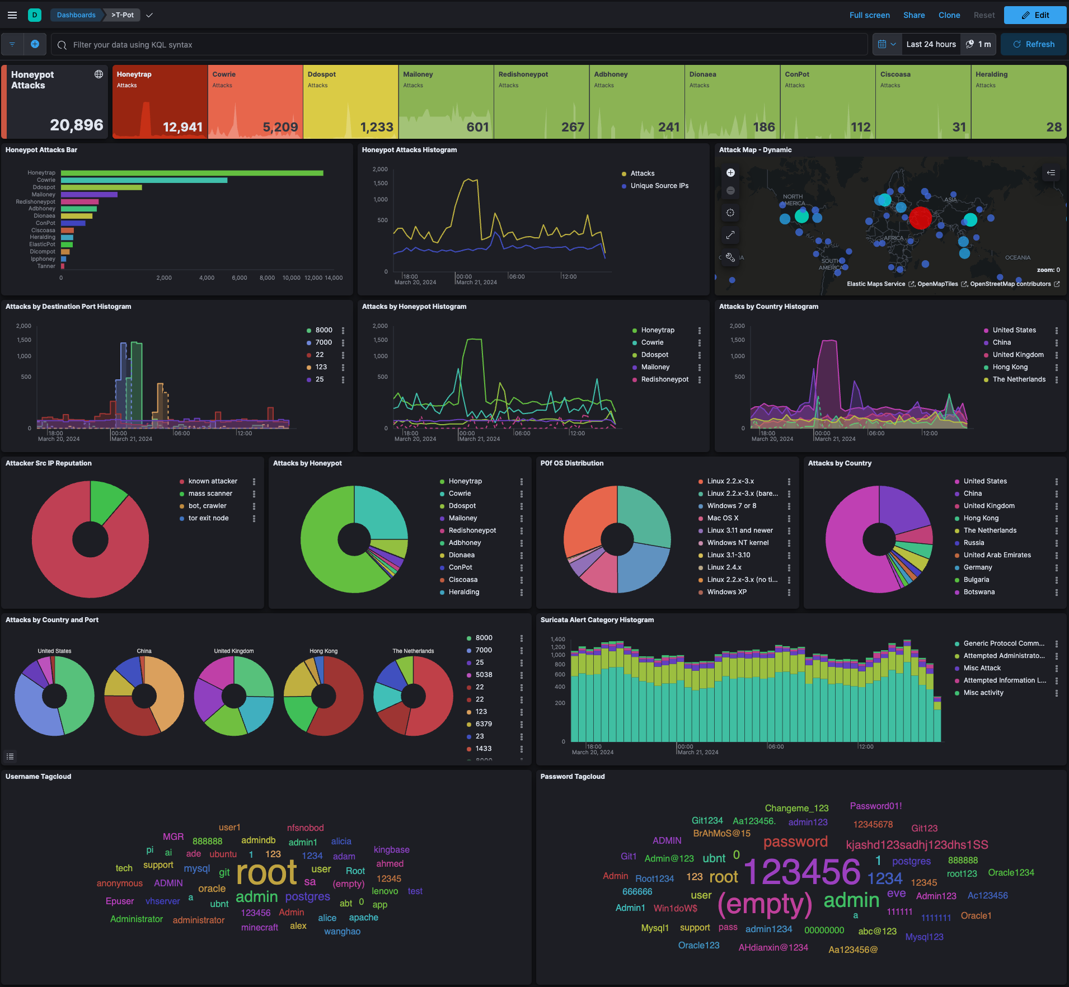
T-Pot Deutsche Telekom Security GmbH
Notes:
https://github.com/telekom-security/tpotce

Slide 29
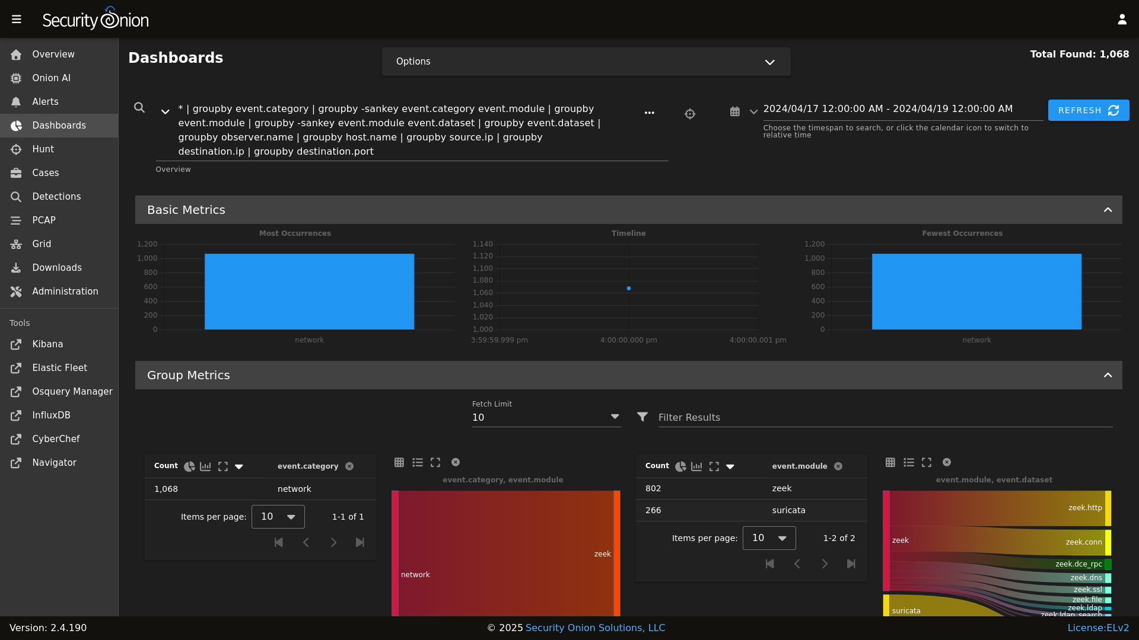
Security Onion
Notes:
https://github.com/telekom-security/tpotce

Slide 30

Government Support
CISA Advisory: Strengthening Cybersecurity of SATCOM Network Providers and Customers
Updated May 10, 2022: The U.S. government attributes this threat activity to Russian state-sponsored malicious cyber actors. Additional information may be found in a statement from the State Department.
Actions to Take Today:
• Use secure methods for authentication.
• Enforce principle of least privilege.
• Review trust relationships.
• Implement encryption.
• Ensure robust patching and system configuration audits.
• Monitor logs for suspicious activity.
• Ensure incident response, resilience, and continuity of operations plans are in place.
CISA Shields Up!
https://www.cisa.gov/news-events/cybersecurity-advisories/aa22-076a
Notes:
https://www.cisa.gov/news-events/cybersecurity-advisories/aa22-076a
https://www.cisa.gov/shields-up

Slide 31
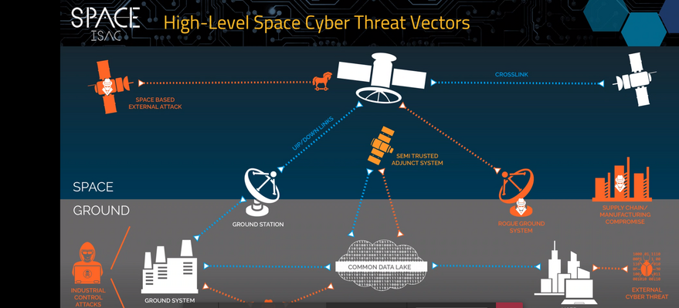
SPACE ISAC 2019

Slide 32
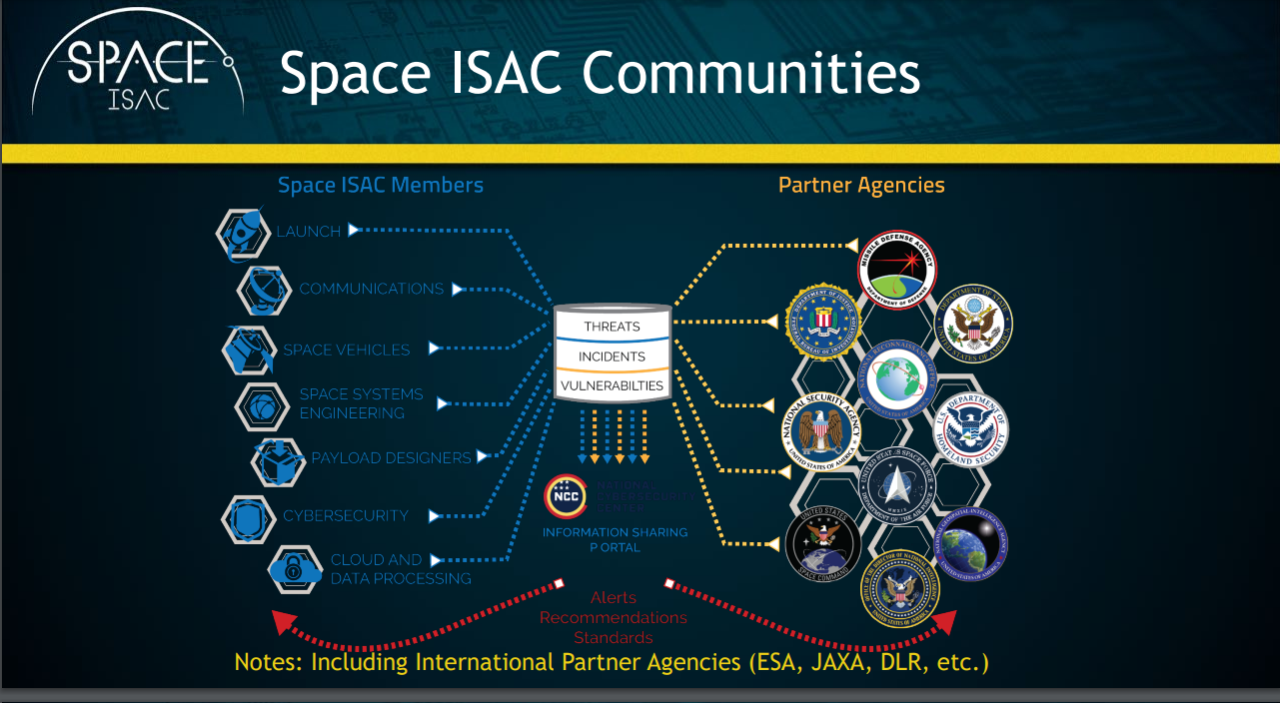
Notes:
https://www.nesdis.noaa.gov/s3/2022-08/1.%20ACCRES%20-%20Space%20ISAC%20Brief.pdf

Slide 33


The Future Defender…..Today
What kind of training would new space defenders need to be successful at protecting corporate and national assets?
Training
Blue/Red a Mix of Both!
Understanding your system is critical
Knowledge Areas
Programing/Scripting
Cloud Technologies
IoT Systems
Software Defined Networks (SDN)
Network Monitoring
Forensics
Incident Response

Slide 34
Have Questions?
Scott.Lynch@slteksystems.com
LinkedIn @PacketEngineer
Twitter @PacketEngineer

